Slide 1
Gambling

Slide 2
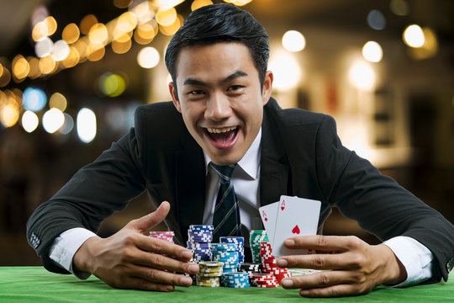
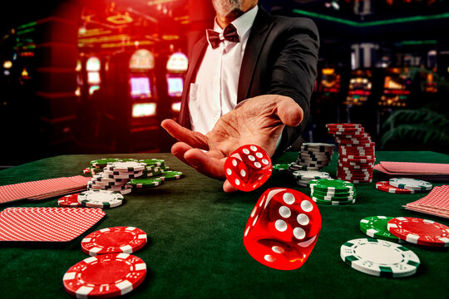
Question: Is gambling legal in the US?

Slide 3
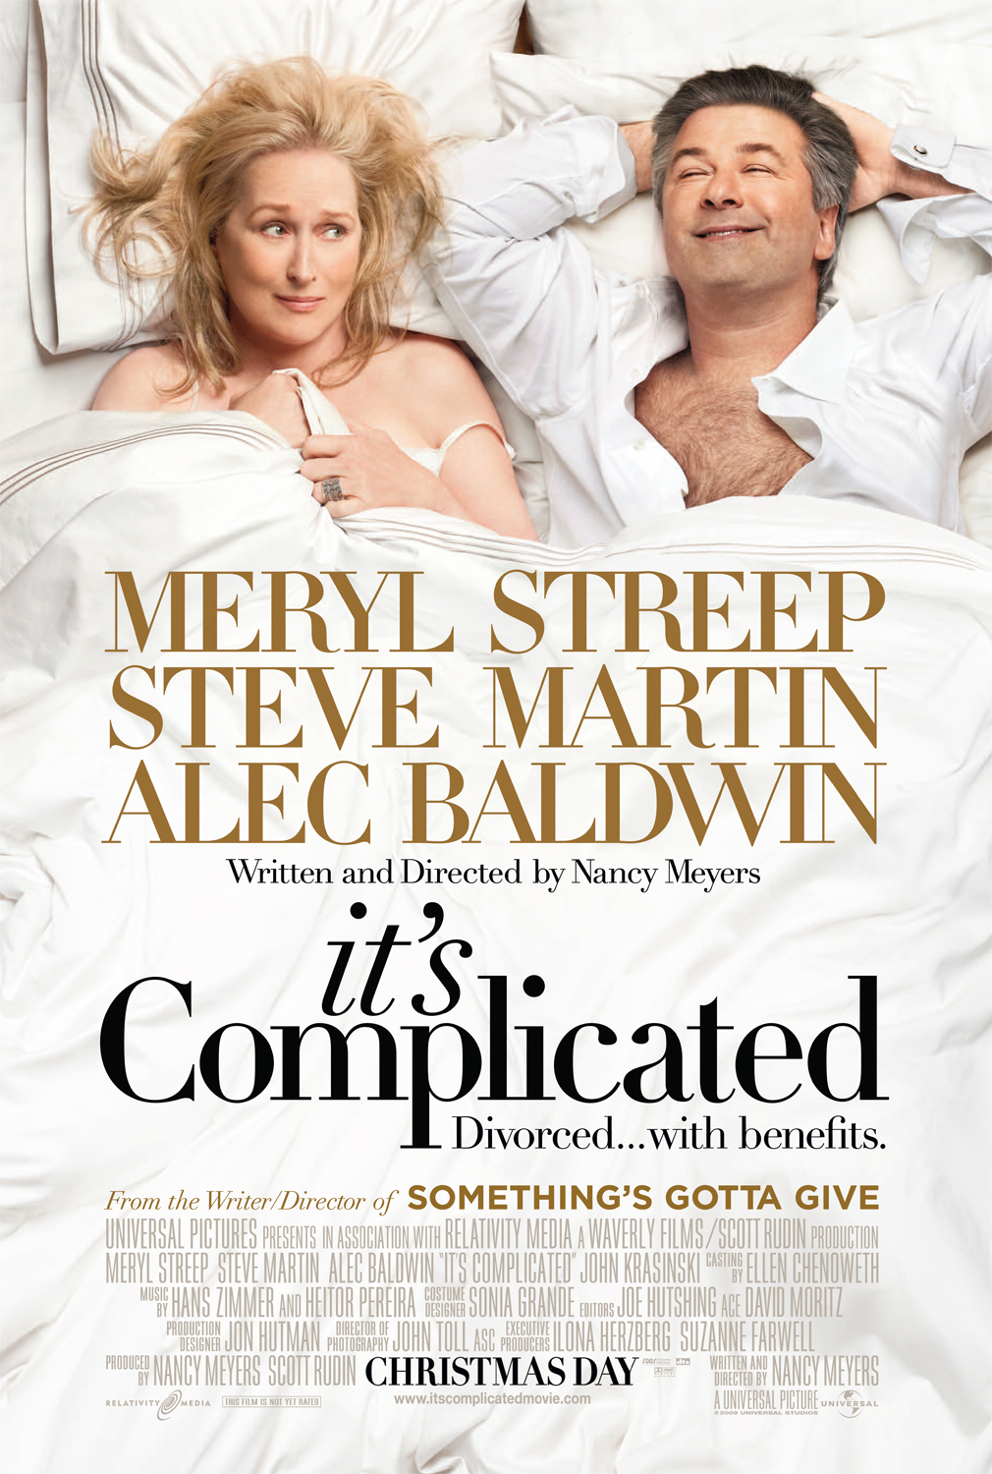
It’s complicated.

Slide 4
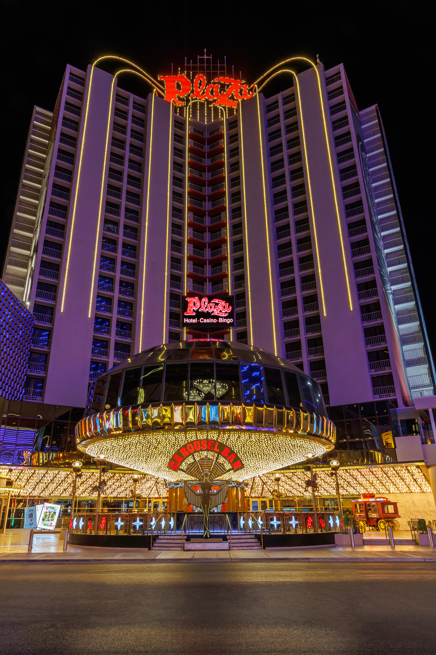
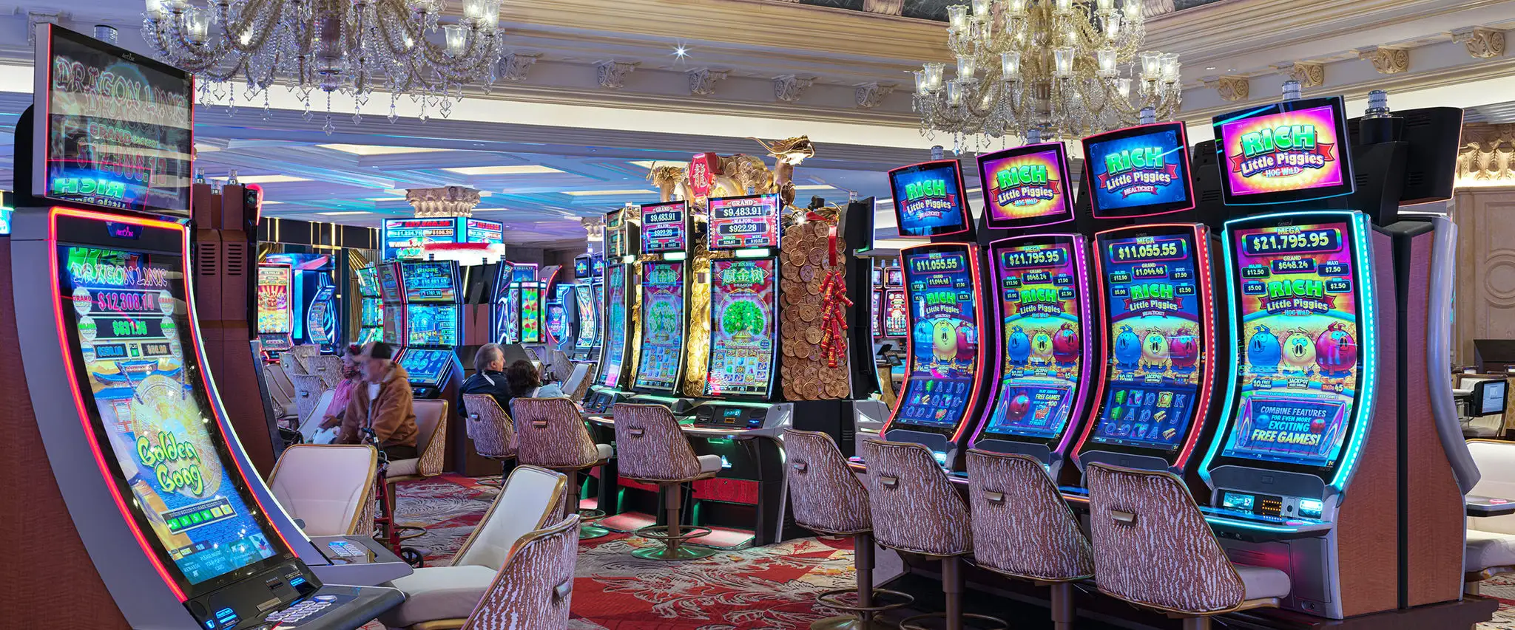
Casinos

Slide 5
How do casino games work?
CASINO GAMES · 1 OF 2
Roulette
Blackjack
Slot machines
The dealer spins a wheel and rolls a small ball. Bet on where it stops: a number, red or black, odd or even.
Get closer to 21 than the dealer without going over. Take another card (“hit”) or stop (“stand”).
Put in money and press “spin”. The reels stop at random; matching symbols in a line win a prize.
Words: hit · stand · bust · dealer
Words: reel · jackpot · payout · spin
Words: wheel · spin · bet on · red / black
HOUSE EDGE
HOUSE EDGE
HOUSE EDGE
2.7%
~0.5%
2–15%
European wheel; 5.3% in the US
only with perfect play
depends on the machine
House edge = the share of every bet the casino keeps on average, in the long run.
Notes:
Warm-up: Which of these games have you seen in a film or played as a video game? Pre-teach "hit / stand / bust" by acting them out. Link back to the dice game: our game kept about 1/6 of each bet (around 17%), far more than real roulette. Why do casinos not need a big edge? (Lots of bets, every day.)

Slide 6
How do casino games work?
CASINO GAMES · 2 OF 2
Poker
Baccarat
Craps
Everyone gets 2 secret cards, then 5 shared cards are dealt. Make the best hand, or bluff so the others give up.
Bet on the “Player” or the “Banker” hand. The hand closest to 9 wins. You only choose your bet; the dealer does the rest.
Bet on a roll of two dice. First roll: 7 or 11 wins, 2, 3 or 12 loses. Any other number must come again before a 7.
Words: fold · call · raise · bluff
Words: hand · banker · tie · deal
Words: dice · roll · shooter · point
THE CASINO'S CUT
HOUSE EDGE
HOUSE EDGE
~5%
1.1%
1.4%
fee (“rake”) from each pot
on Banker; 14.4% on Tie
on the basic “pass” bet
House edge = the share of every bet the casino keeps on average, in the long run.
Notes:
Poker is the odd one out: players bet against each other, so skill matters and the casino just takes a fee. Ask: Is poker gambling or a skill game? (Link to Austria: sports betting counts legally as a game of skill.) Pronunciation: baccarat = BACK-uh-rah (the final t is silent). Quick quiz: Which bet on this slide is the worst deal for the player? (The baccarat Tie bet, 14.4%.)

Slide 7
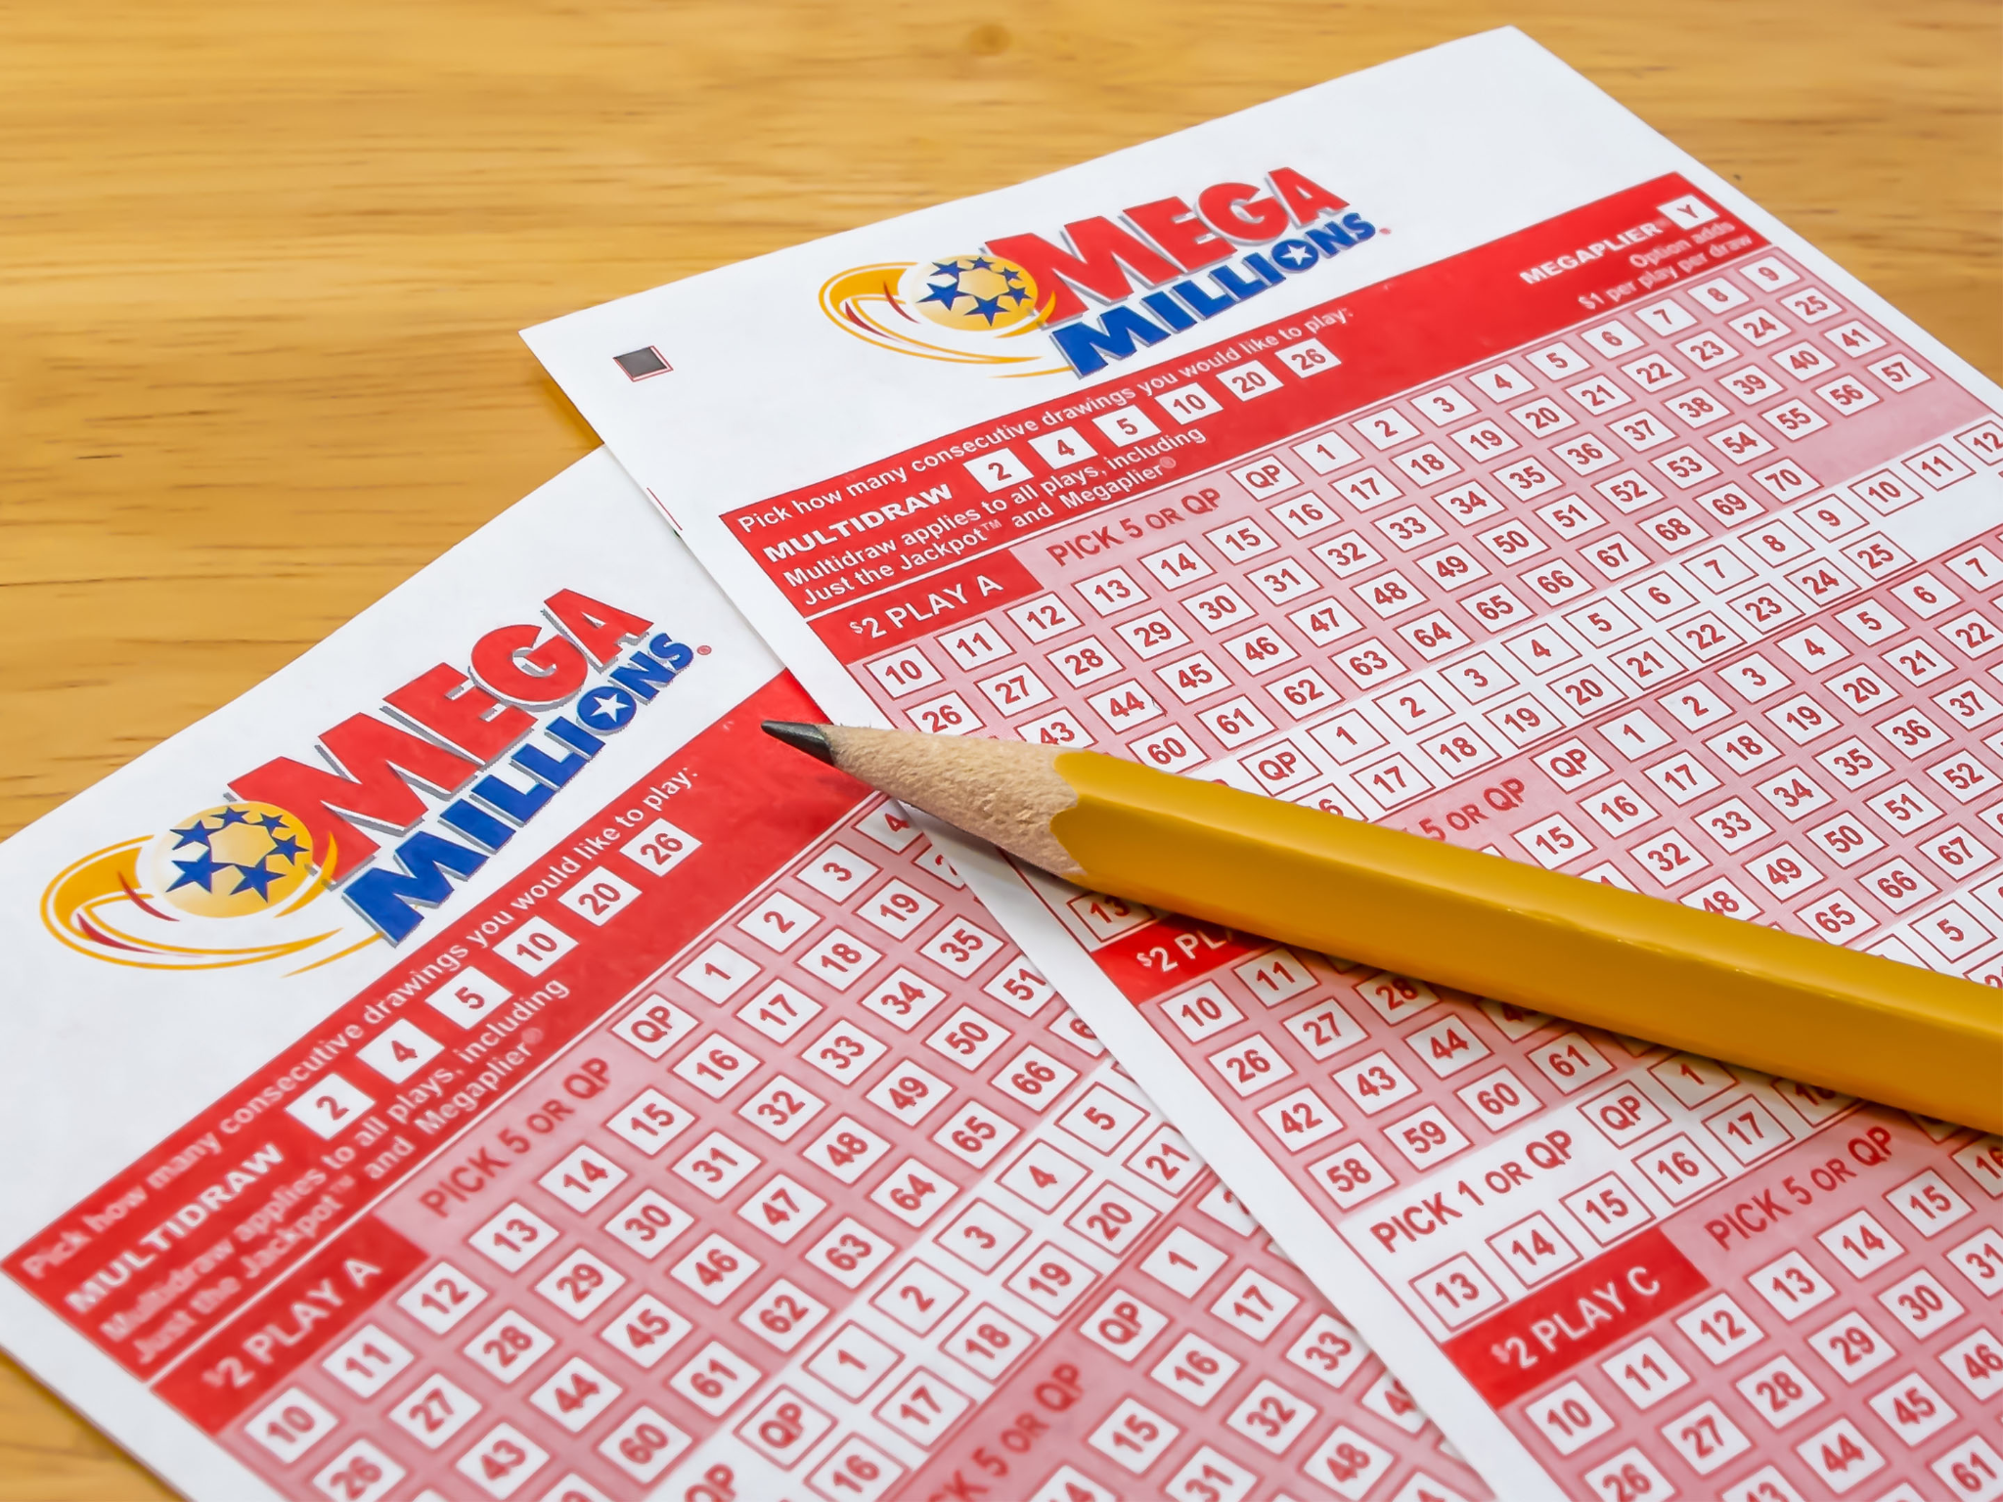
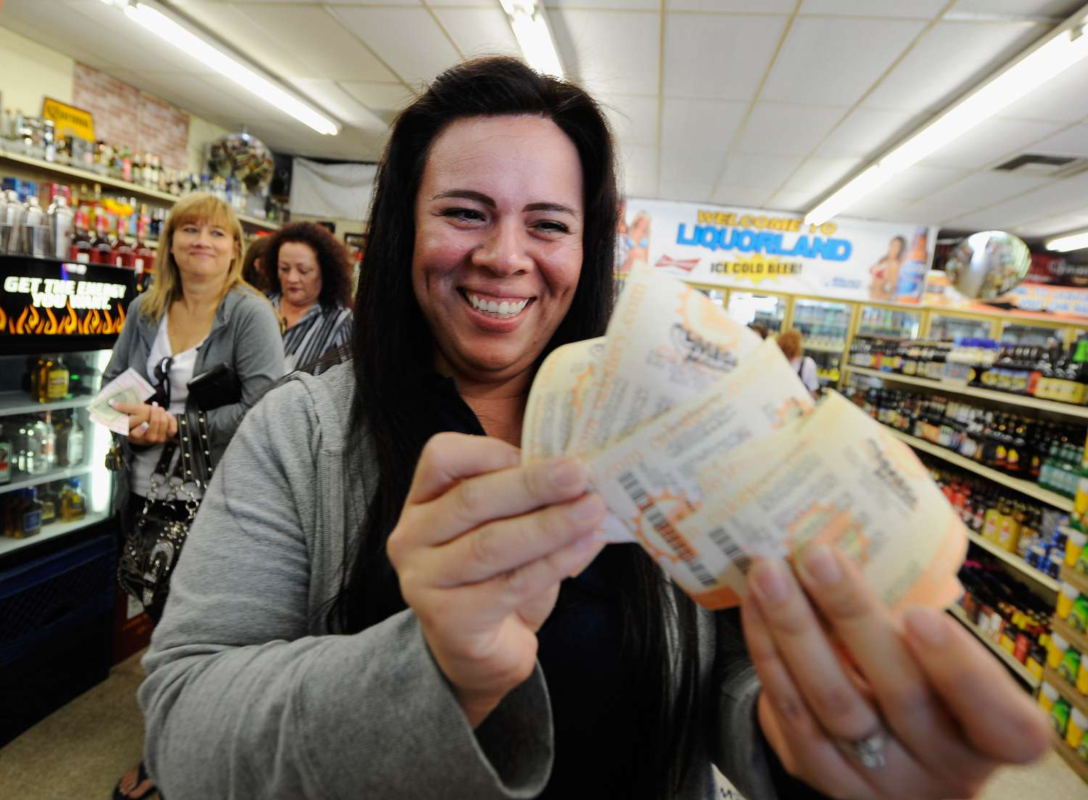
Lotteries

Slide 8

Lotteries cont.

Slide 9
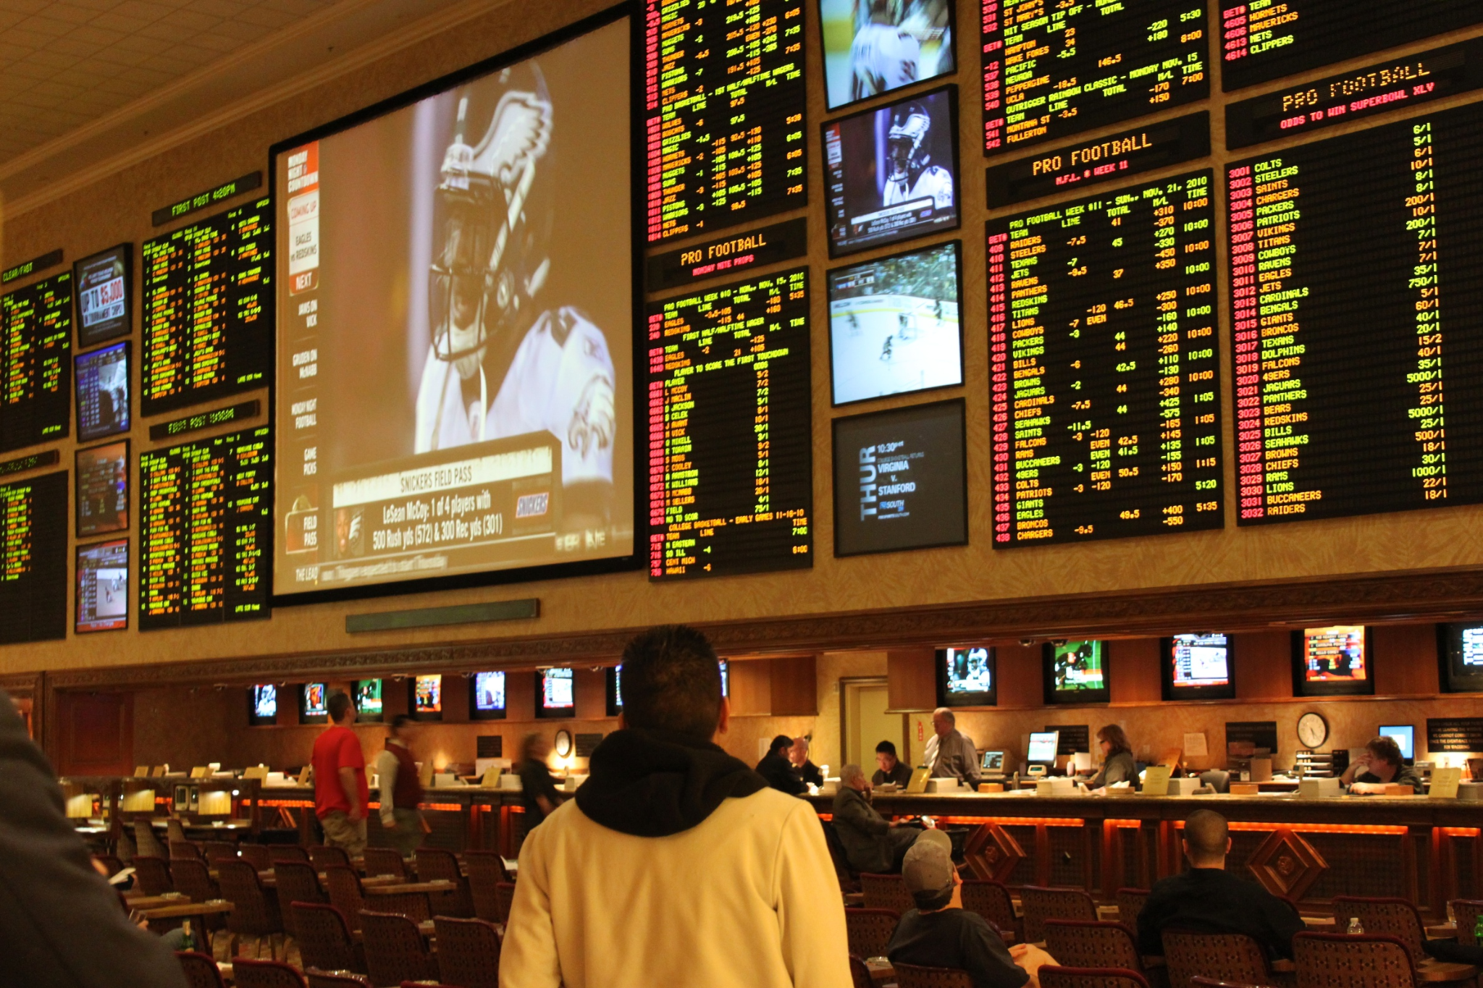
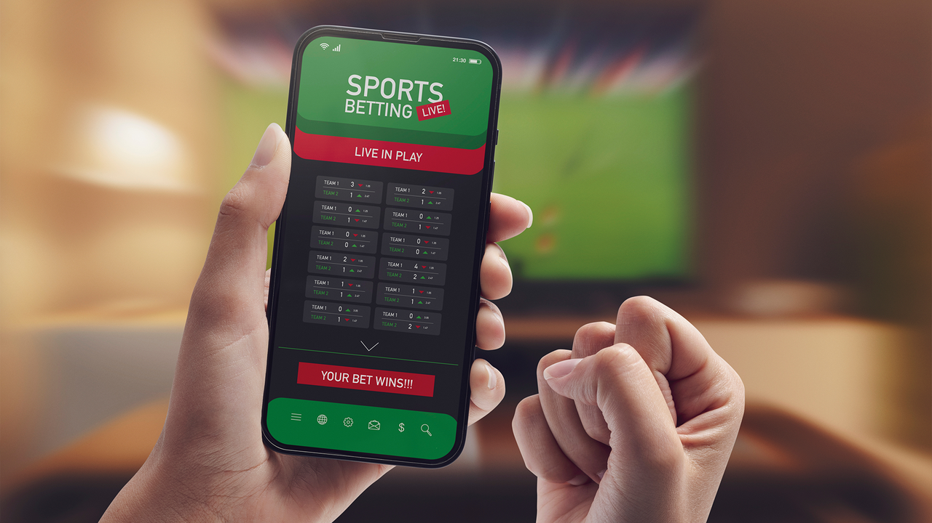
Sports betting

Slide 10
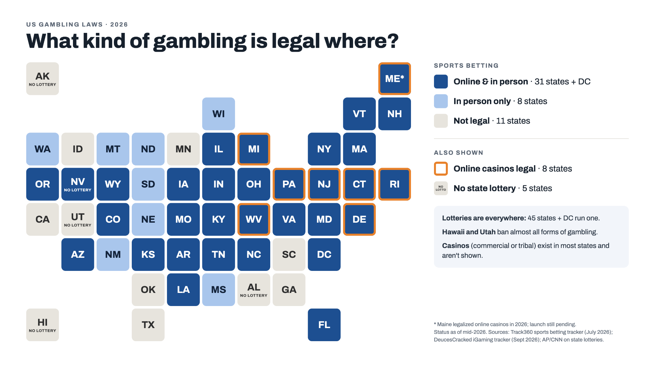

Slide 11
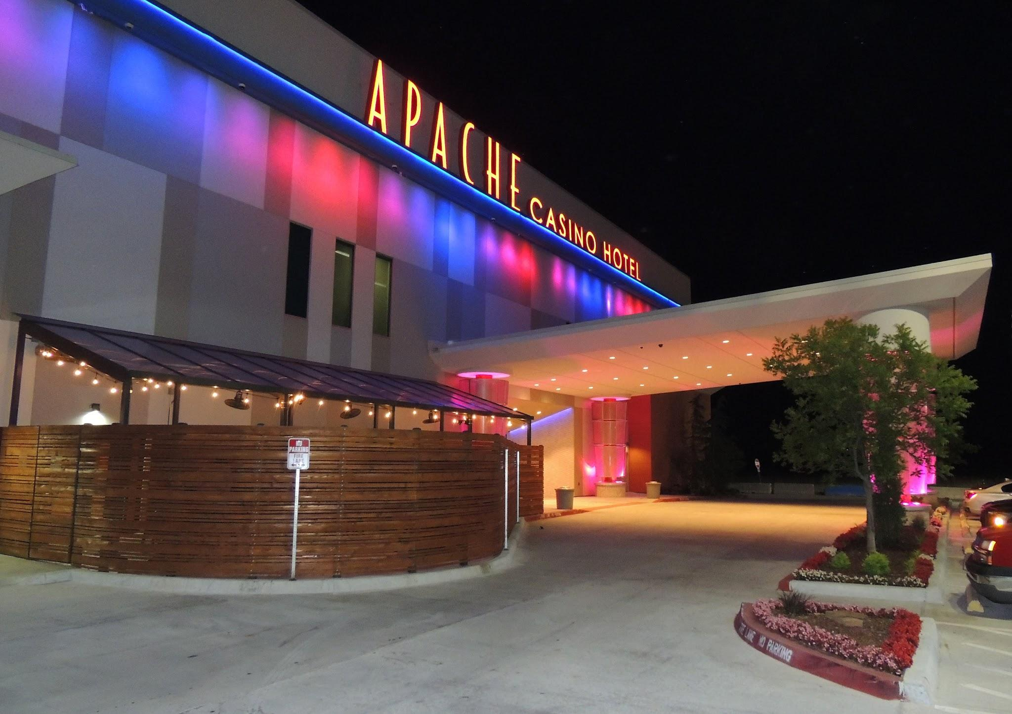
An important footnote: Native American Gaming

Slide 12
Which one of these is most popular?
(by people)

Slide 13
Guess the number
31%
14%
21%

Slide 14
Guess the number
31% lottery
14% casino
21% sports betting

Slide 15
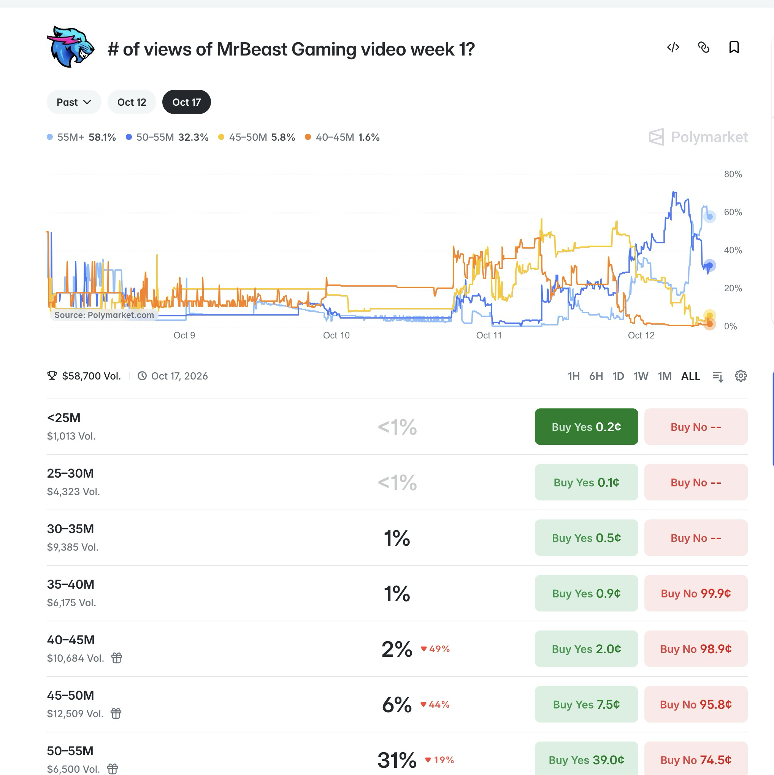
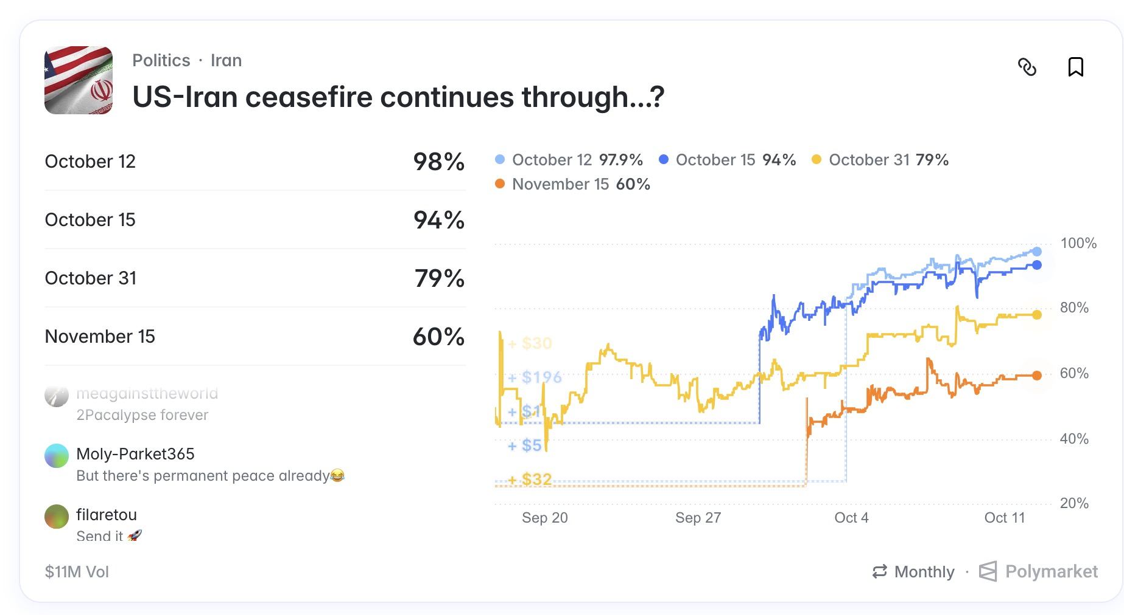
The Grey Market

Slide 16
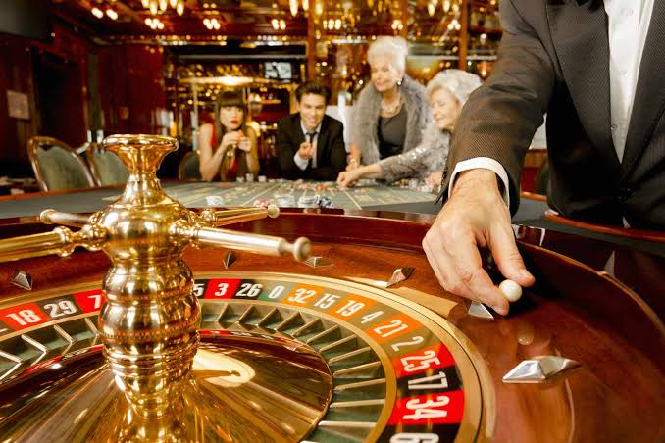
Grammar Casino

Slide 17
He betted all his money on Rapid.

Slide 18
The money he had won, he spent within a week.

Slide 19
The odds are against you.

Slide 20
I have played poker since three years.

Slide 21
The number of teenagers who gamble online have increased.

Slide 22
If I would win the lottery, I would buy a house.

Slide 23
She has been gambling online for two years.

Slide 24
He denied to have a gambling problem.

Slide 25
Sports betting is very popular in Austria.

Slide 26
I am agree that sports betting should be banned.

Slide 27
The house always wins in the long run.

Slide 28
He promised to stop, but he didn’t stopped.

Slide 29
Young men are more likely to bet on sports than women.

Slide 30
Gambling can become a serious addiction.

